Slide 1

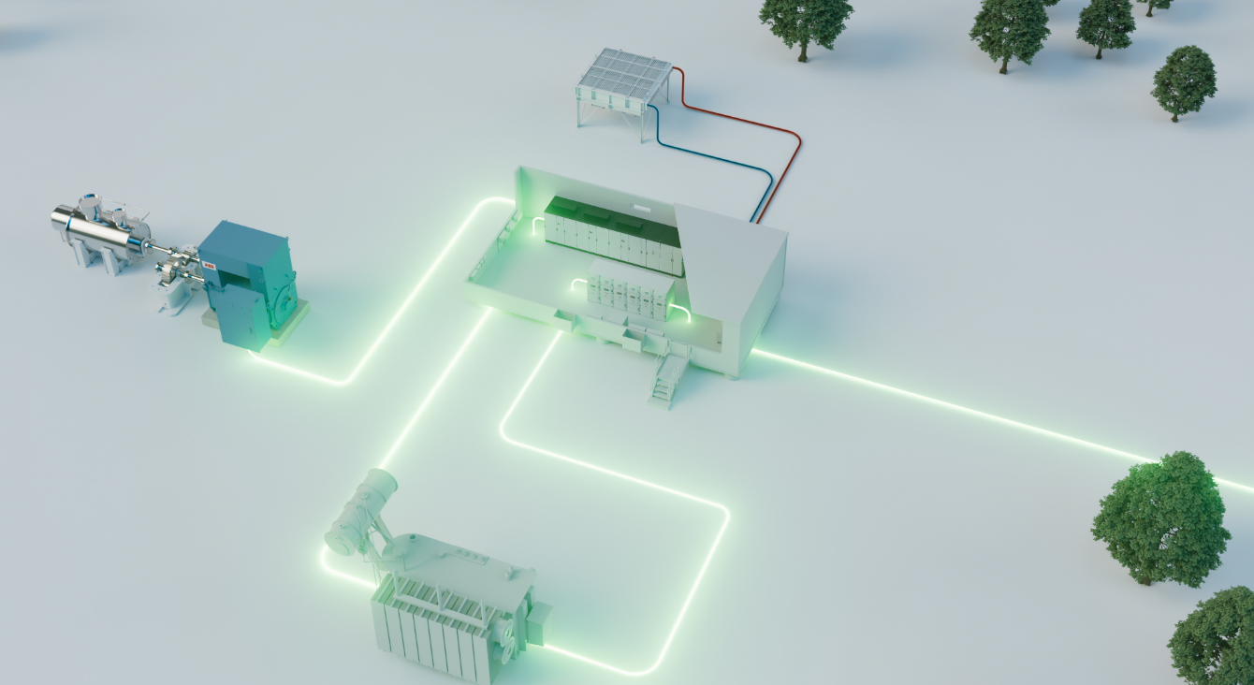


ABB MOTION HIGH POWER
ABB Variable Speed Drive Systems
Enable customer success by delivering efficient and
reliable VSDS¹ solutions– energized by passion
© 2026 ABB. All rights reserved.
1. Variable Speed Drive Systems

Slide 2




Navigator
ABB Motion High Power overview
Our approach
Reference cases
01.
02.
03.

Slide 3
—
ABB Motion High Power overview
The trusted global market leader
01.

Slide 4
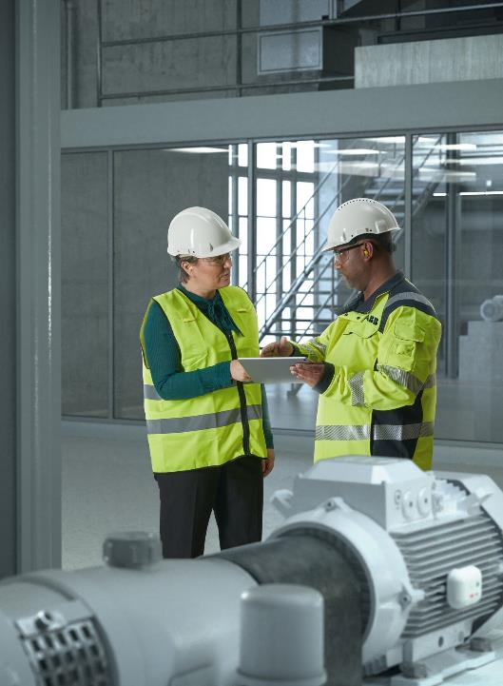







—
Get to know us
140 years
of technology and innovation
Global leader
in high power portfolio
$7 billion
estimated global opportunity¹
14
factories
Who we are
Global market leader in high-power, high-performance motors, drives, generators, power conversion and packaged solutions.
+100 countries
with local representatives
>6.4k
employees globally
Contact us
¹ Estimated power generation market size

Slide 5
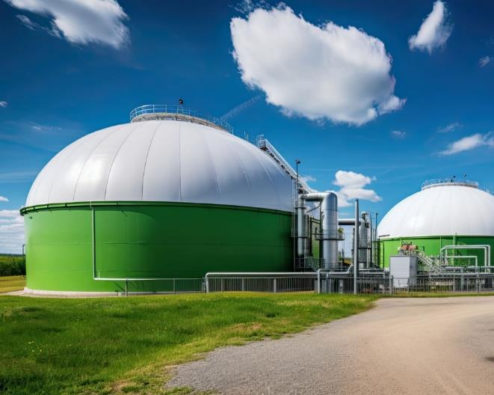
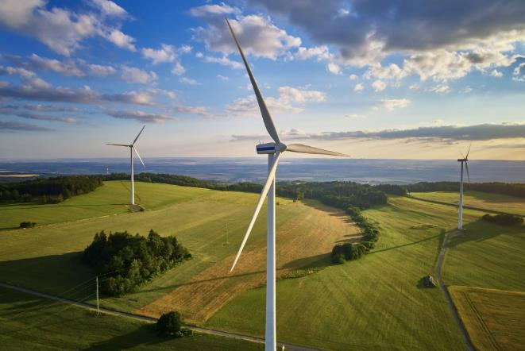

—
What we promise
Performance and reliability for mission critical applications
Backed by decades of experience in critical industries, we offer a unique high-power portfolio spanning from standard products to complete tailor-made systems, to help you outrun your operations performance with unmatched reliability and precision
Energy efficiency and
productivity lead our agenda
Our Top Industrial Efficiency (TIE) initiative offers you the highest efficiency available without compromising
on reliability, helping you reduce emissions and lower the total cost
of ownership
We’re driving towards net zero
We apply our technology and experience to produce solutions that will help you reduce your carbon emissions while increasing productivity and competitiveness

Slide 6

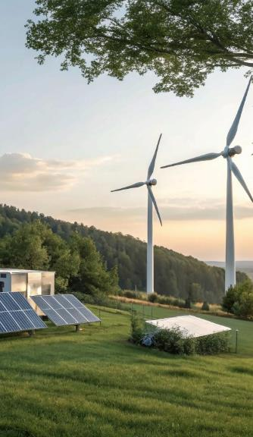



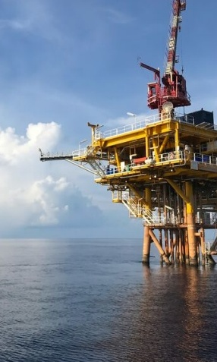


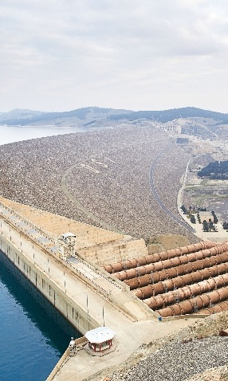
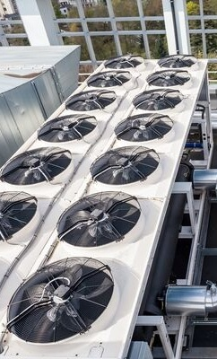
—
Where can you
find our solutions?
Infrastructure
Pulp and
paper
Power
Data center
Food and
beverage
Metals
Chemical, oil
and gas
Cement
and mining
Marine
Water and
wastewater
HVAC
across all industries

Slide 7














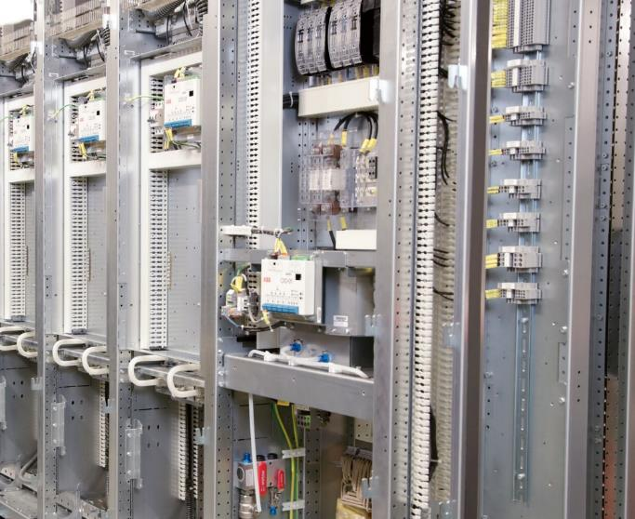
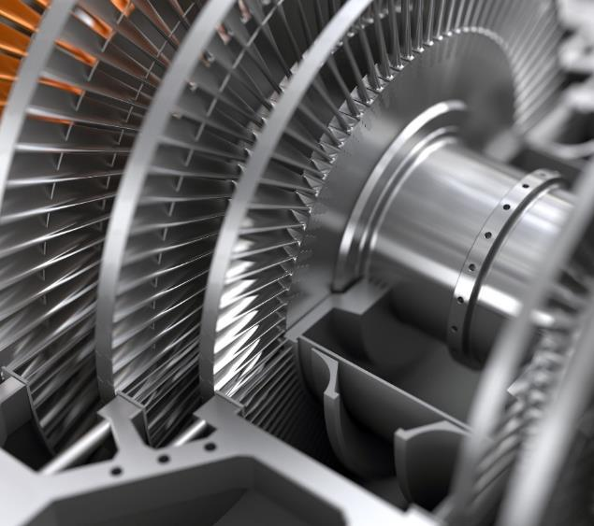
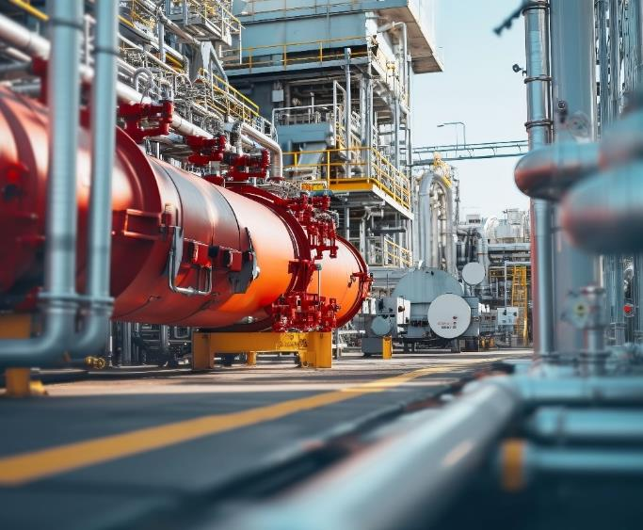
—
Powering the world’s mission critical applications
Fans
Pumps
Compressors
Extruders
Thrusters
Propulsions
Conveyors
Rolling
mills
Shredders
Centrifuges
Electrolyzers
Electric
heatings
Wind
turbines
Heat
pumps
© 2026 ABB. All rights reserved.
Slide 7

Slide 8





—
Energy efficiency
makes the difference
Enhancing the energy efficiency of industrial motors is crucial for reducing energy waste and electricity costs
For example, by committing to our high efficiency motor and generators solutions, you could reach 1,6TWh in electricity savings
during a product's lifetime
Increased motor or generator efficiency
can also reduce your energy-related
CO₂ emissions by 40%
Adding a drive to a motor can further reduce energy usage by 25%. Yet more than 75% of the world’s motors are not connected with a drive

Slide 9

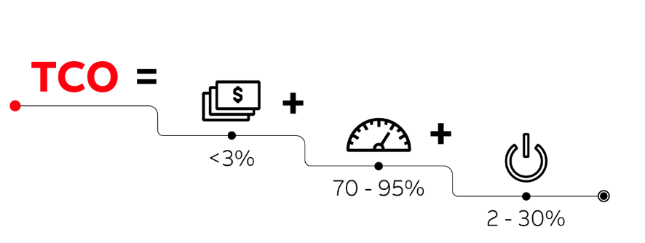
Energy efficiency and TCO – what it means to you
99.13%
efficiency¹
With such high-efficiency ratings,
our motors and drives are capable of producing massive energy savings
How we can lower the TCO
  Highly reliable components
  Process optimization
  Equipment protection
  High-efficiency drives and motors

Slide 10

The Top Industrial Efficiency option in numbers
Based on data from more than 100 cases
Average payback time of:
$66,880¹ annual savings
and
160,000 kg CO₂ emissions avoided (equivalent to powering 33 homes for a year)
1. assuming an electricity cost of $0.2/kWh
Your decision today impacts
your future for
0.5-3 years
→
→
25 years
Investing just ~5% more in the TIE option can deliver:

Slide 11
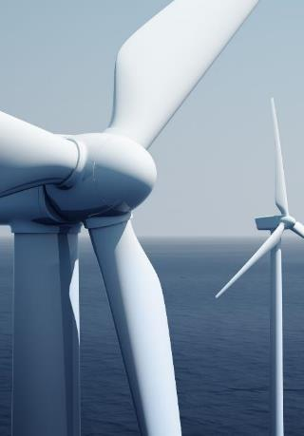
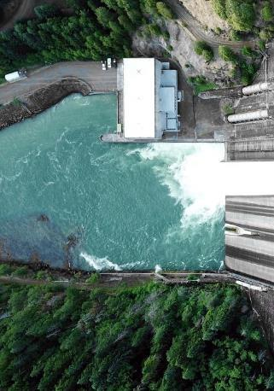
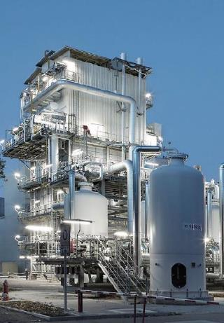
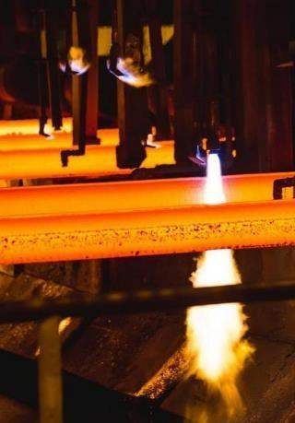
Decarbonizing industry
across the value chain
Enabling renewable
power generation
Improving
grid stability
Developing emerging
applications
Decarbonizing industrial
process and transportation
Notes:
Enabling renewable power
Enabling renewable power plants to run efficiently, reliably, and cost-effectively with our energy-efficient AMS synchronous motors and our AMG synchronous generators
Improving grid stability
Supporting grid stability by providing power conversion equipment for integrating energy storage systems like pumped hydro, batteries, and compressed gas
Offering instantaneous fault protection and stabilize network frequencies with our SCs by restoring the essential rotating inertia needed to ensure constant voltage in grids heavily utilizing wind and solar power
Allowing Renewable Power Network suppliers to maintain power grid stability for their customers with our synchronous condensers
Developing Emerging applications
Offering a dedicated rectifier portfolio for green hydrogen, featuring IGBT, Thyristor, and Diode technologies
Powering multiple emerging applications with our motors and generators including carbon capture and storage (CCUS), hydrogen, energy storage, turbine-to-electric conversion, LNG, and data centers
Decarbonizing industrial process and transportation
Replacing fossil-fuel-powered equipment in industry and marine transportation with electric solutions significantly reduces emissions
Electrification technologies, supported by Variable Speed Drives (VSDs) for precise control, enhance energy efficiency and adapt across temperature ranges and processes
Allowing shipping companies to reduce their fleet’s emissions and adhere to International Maritime Organization (IMO) regulations with our Permanent magnet shaft generators

Slide 12





Technology leadership & industry expertise
Market leading
investments in R&D
Digitally enabled portfolio
Market leading
Cybersecurity & connectivity
Reliability as a
competitive advantage
Trusted partner for over 140 years
Proven expertise solving customers’ most demanding engineering challenges.
Enabling the energy transition
Supporting groundbreaking carbon capture, geothermal, and hydrogen projects with advanced technologies.
Comprehensive, reliable portfolio
Standard and customized solutions built for mission-critical performance and evolving customer needs.

Slide 13
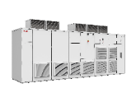
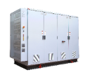
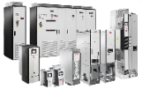


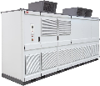

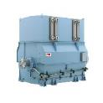
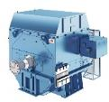

Motion High Power Portfolio for reliability and performance
Medium Voltage System Drives
Air-cooled and high-power MV drives
Low Voltage System Drives
Power controllers, LV and DC drives, modules and cabinets for industry, infrastructure and utilities
Packaging
Optimized, high-end, and energy-efficient variable speed drive systems
Renewable Power
Wind turbine converters and power supply solution for electrolyzers, incl. services and digital solutions
Induction Motors
Induction motors (modular, rib-cooled and flame-proof motors) for efficiency, reliability and availability
High-Speed Synchronous
High-speed synchronous motors, steam and gas turbine generators and synchronous condensers
Slow-Speed Synchronous
Slow-speed synchronous motors and engine generators

Slide 14
—
Our approach
02.

Slide 15









What are Variable Speed Drive Systems?
Grid
Switchgear
Power Cables
Transformer
E-House
Drive
Cooling
We reduce risks, simplify design and equipment selections by providing complete, high-end and energy-efficient package solutions for our customers
Control
Process
Electrical Motor

Slide 16





Optimized Variable Speed Drive Systems
One-stop shop for VSDS solutions
Full ABB responsibility
Sustainability and efficiency
Project simplification
Domain expertise and know-how
Profitability boost
Choose a supplier who will give you peace of mind. Let us take full responsibility for your Variable Speed Drive Systems.
Build and operate your plant in the most efficient way. Our solutions will help you to reach your energy efficiency, emissions, and OPEX targets.
Simplify the project and buying processes. The easiest, most flexible and efficient way to execute Variable Speed Drive Systems.
Benefit from our domain expertise and know–how.
Our optimized solutions are based on extensive industry experience.
Cut production losses and boost profitability.
Maximize uptimes and minimize unexpected costs thanks to our reliable products, global service network and digital services.
Notes:
Value proposition for Variable Speed Drive Systems:
We take technical and commercial responsibility for coordinating the entire Variable Speed Drive Systems, helping you to reduce risk and giving you full confidence in the outcome
Our optimized and highly efficient Variable Speed Drive Systems help you to comply with environmental regulations and standards by eliminating CO₂ emissions and reducing energy consumption
We can help you to simplify the overall project process. We effectively coordinate the management of your project, and we provide you with a single channel for communications and sourcing
We ensure the optimal fit of our motors and drives product portfolio to match customer needs
Our reliable products, global service network and digital services will help you to boost your profitability by reducing very expensive downtimes

Slide 17


Value proposition proof points per segment
Value proposition for Chemical, Oil and Gas
Value proposition for Mining & Cement
Value proposition for Metals
Value proposition for Special Applications

Slide 18







—
Regional TEC EUC & DE, Ladenburg, Germany
Business Line Packaging global presence
Domestic TEC, Italy
Domestic TEC, Canada
Domestic TEC,
China
Domestic TEC, USA
Global TEC
Turgi, Switzerland
Worldwide 14 Tendering
and Execution Centers
within Motion High Power
Regional TEC APAC & JP
Japan, Tokyo
Domestic TEC, UAE
Regional TEC LTAM
Santiago, Chile
Tendering and Execution Center
Sales
Regional service center
Domestic TEC
Regional TEC MEA & IN, Bangalore, India
Global service center
Domestic TEC, Brazil
9
5
80+
~1200
~600
Domestic Tendering
and Execution
Centers (TECs)
Regional and
Global Tendering
and Execution Centers
Countries with local
representatives
ABB field
service engineers
Service
partners
Notes:
We are at the forefront of creating new ways to maximize the operational uptime through preventive servicing, spare part availability, superior service delivery, and support. Our well-connected global network of more than 50 dedicated service workshops, over 1,200 certified field service engineers, and more than 600 service partners, help to keep your equipment in peak condition. Safety and quality are central to our philosophy, and we strive to continuously meet your requirements, whether to meet sustainability goals, maximize uptimes or lower the total costs of ownership.

Slide 19
LSUs vs TECs – The difference
Global Business Line Packaging
Local Sales Unit
Domestic TEC
Regional TEC
Global TEC
Complexity
Scope of supply to customers | Everything within a Product supply: Mostly configured-to-order and only little engineered- to-order | Engineered package of products/services containing: Project management, integration engineering, product engineering, supplier qualification and supply management, technical or commercial cross-coordination or risk management.
 |  | Package scope typically comprising: Drives Motors, transformers, switchgears with single feeders, e-houses, fin fan, cables selection Third party supplies Special testing required below 4 MW Field services |  | Mid including also: Global OEMs and project pursuits Packages for special applications¹ Packages with complex components, such as: harmonic filters, chillers or PLCs² Special testing required above 4 MW
Project responsibility | Any country with ABB offices | Specific country (BR, CA, CN, DE, JP, IT, IN, US, UAE) | Specific region (APAC, EUC, LTAM, MEA) | Global
Governance | Business Lines and local management | Global governance through Business Line Packaging
Low
Typically – Mid
Typically – High
Notes:
Reason: to explain customers why they might be contacted by different teams (because we cathegorize our business)

Slide 20
—
Reference Cases
03.

Slide 21
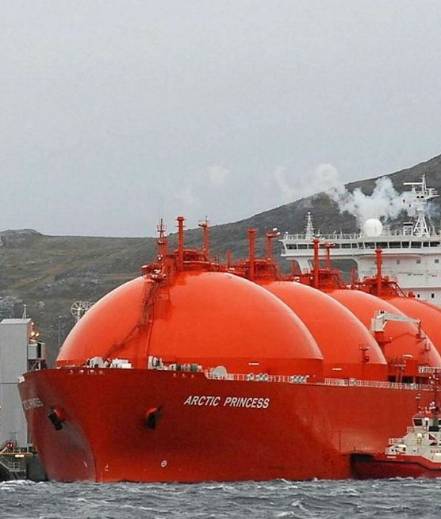



Delivering trust through proven execution and strong collaboration
→
Project reference:
OIL AND GAS
Who?
The Snøhvit project, located at the Hammerfest LNG plant in Norway, is a flagship initiative led by Equinor and supported by major industrial partners. It is recognized for pioneering electrification and carbon reduction in LNG production
What?
The project involved the deployment of advanced Variable Speed Drive Systems for feed gas compressor trains, including: converter transformer connected to 132kV in hazardous zone 2 (cat III), 28MW water-cooled MEGADRIVE-LCI driving >98% efficiency AMS synchronous motor, harmonic filter systems meeting Norwegian regulations, string test alongside compression OEM
Why?
Ability to deliver with speed, quality, and reliability - backed by a strong track record of execution in complex projects.
Proactive approach, proven collaboration, and commitment to compliance and continuous improvement built the trust and confidence needed for a successful partnership
Notes:
https://new.abb.com/news/detail/57490/clean-energy-from-our-seas

Slide 22
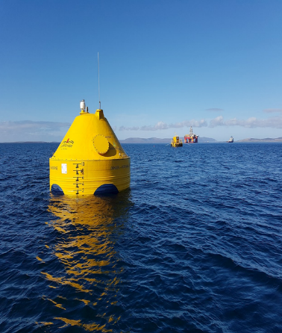
Sustainable solutions for the energy supply of the future
→
Project reference: POWER GENERATION
Who?
Cooperation project with CorPower Ocean, which has developed a prototype in the form of a buoy that takes wave power and turns it into electricity
What?
Two medium voltage motors
Medium voltage switchgear
Frequency converters
Control software for test stand applications
Installation
and commissioning
Why?
Highly customized test stand solution for a unique customer case
Commitment to sustainability extends beyond the product offering
Notes:
https://new.abb.com/news/detail/57490/clean-energy-from-our-seas

Slide 23

Efficient integration and complex constraint management in a 60MW pump storage power plant
→
PROJECT REFERENCE: POWER GENERATION
Who?
VERBUND is Austria's leading electricity company and one of the largest producers of electricity from hydropower in Europe. Close to 100% of our electricity generation comes from climate friendly, renewable hydropower
What?
75 MVA OFWF 6-winding transformer (ETD / CZ) incl. additional filter winding
Tripple-branch harmonic line filter
60 MW rated liquid cooled LCI drive, 24-pulse thyristor rectifier, 2 x 6-pulse inverter
60 MW @3000rpm rated synchronous motor (Jeumont Electric/FR)
Power cables, incl. installation material
Heavy lifting and installation
Why?
Looking at brownfield integration, ABB designed the most compact solution for 60MW pump storage power plant
While integrating various 3rd party equipment, ABB’s services on site comprised lifting and installation thoroughly planned to cope with complex constraints given by an existing powerhouse and its space limitations
Notes:
https://www.verbund.com/en-at/about-verbund
What:
Unloading, installation, commissioning of the VSD system (ATABB, supported by CHABB)

Slide 24
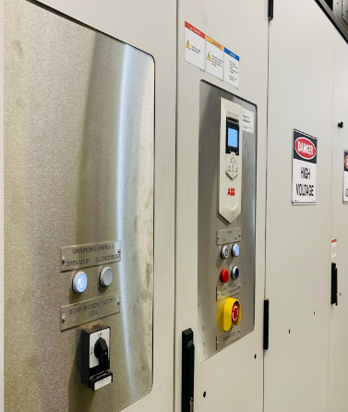
Increasing power and decreasing energy consumption in metal shredding system application
→
PROJECT REFERENCE: metals
Who?
Sims Metal, a division of Sims Limited, is a leading metal recycler that buys, processes, and sells ferrous and non-ferrous metal. Their purpose is to create a world without waste to preserve our planet
What?
ACS6080 medium voltage
AC drive and motor and transformer package
Why?
Subsequent energy cost savings and the higher ton per hour in material processing thanks to the increased power of the system overall
Notes:
https://new.abb.com/news/detail/102068/abb-medium-voltage-drive-selected-by-sims-metal-to-increase-power-and-decrease-energy-consumption-in-metal-shredding-system-application

Slide 25
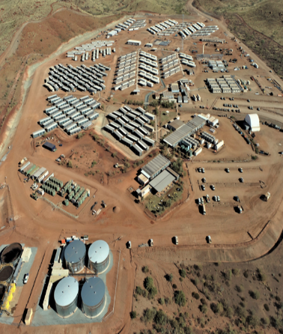
Optimized VSDs for a new Magnetite Mine
→
PROJECT REFERENCE: MINING
Who?
The Iron Bridge Magnetite Project, an unincorporated joint venture between Fortescue’s subsidiary FMG Magnetite Pty Ltd and Formosa Steel IB (Iron Bridge Joint Venture), covers the development of a new magnetite mine, including processing and transport facilities
What?
Drives (incl. multidrives) and motors of various voltages,
e-rooms, transformers, engineering and project management to ensure smooth integration
Why?
Complete drive system for all the applications providing industry-leading energy efficiency, reduction of operational cost thanks to optimized footprint and reduced HVAC installation needs
Notes:
https://new.abb.com/news/detail/70832/abb-wins-356million-aud-contract-for-fortescues-iron-bridge-magnetite-project-in-Australia
Who?
VSDs delivered for key applications of a new magnetite mine, including processing and transport facilities
Drives package needed for:
High Pressure Grinding Rolls
High Intensity Grinding Mills
Fans
Slurry and water pipeline pumps
Conveyors
What?
ABB MV water-cooled drives for more than 50MV Motors, including Multi-drives, totaling approx. 200MW
ABB LV ACS880 Drives, including Multidrives
High voltage induction motors
E-Rooms for the MV Drives, Chillers
Transformers for all the MV Drives
Related engineering and project management to ensure smooth integration
ABB MV water-cooled drives for more than 50MV Motors, including Multi-drives, totaling approx. 200MW
ABB LV ACS880 Drives, including multidrives
High voltage induction motors
E-Rooms for the MV Drives, Chillers
Transformers for all the MV Drives
Related engineering and project management to ensure smooth integration
Why?
Industry-leading energy efficiency, negligible heat losses minimizing the HVAC installation
Optimized size of E-rooms by smallest footprint of the drives, reducing overall costs
Drives connected to the 33kV line, without the need for step-down transformers
Complete LV/MV Drive system from one supplier for all the applications to ensure the smooth integration and risk mitigation
Industry-leading energy efficiency → Results in OPEX

Slide 26

Rolling out electric powertrain system for ArcelorMittal Nippon Steel’s new steel mill in Hazira, India
→
PROJECT REFERENCE: METALS
Who?
ABB is partnering with SMS group in a multi-million-dollar project supply electrical equipment for
a new hot strip mill at Hazira, in Gujarat. Steel demand to grow by 1.5 times till 2050. ABB supporting industry that makes 9% of global GHG in efficient manner
What?
MV and LV drives gearless solution
Why?
Domain expertise to customer and end-user throughout their decision making
High reliability for applications from auxiliary to highest performance demands
Local servicing ensured and customer support throughout equipment lifetime
Notes:
https://new.abb.com/news/detail/107224/abb-to-roll-out-electric-powertrain-system-for-arcelormittal-nippon-steels-new-steel-mill-in-hazira-india

Slide 27
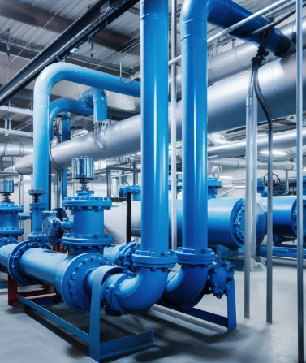
Advancing district heating with high-speed heat pump solutions
→
PROJECT REFERENCE: ELECTRIC HEATING
Who?
MWt Sea Water Heat Pump Compressor
Compressor OEM: MAN Energy Solutions (CH)
Procurement consultant: Tolstrup & Hvilsted ApS (DK)
End-customer: DIN Forsyning Varme A/S (DK)
What?
2 x ACS5000 medium voltage drives, rated for 10.7 MW continuous operation at highspeed motor
4 x 18-pulse drive dry type transformers, rated for continuous operation
Set of commissioning and operational spares
Why?
ABB has been known and long-time partner to various compressor OEM over the decades
Joining forces once more while this time, use of well-proven high-speed solutions in a case of heat pump application for district heating
Notes:
ABB to help decarbonize district heat supply near UNESCO World Heritage area in Denmark

Slide 28
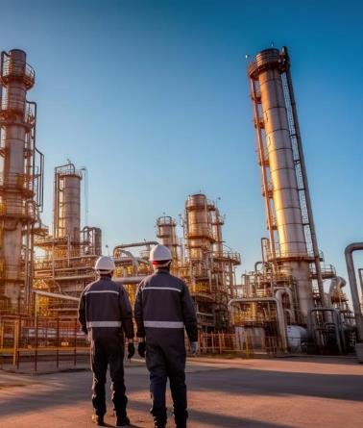
Turning all stones for a successful gas turbine to electrical motor conversion
→
PROJECT REFERENCE: CHEMICAL, OIL AND GAS
Who?
It is a joint venture between the government and a number of foreign stakeholders
Operating several compression trains driven by gas turbines built in the 1970's
What?
ACS5000W medium voltage drive of the newest generation 9.6 MW
Input transformer and ABB induction machine
Successful turbine to electric conversion in defined shutdown time (from May 29–Jun 20, 2023, for VSD system commissioning)
Why?
Turned around an aging installation of an end-of-life gas turbine by replacing it with modern electrical VSDS saving tremendous amounts of energy and emissions
ABB as trusted partner to meet customer’s narrow shutdown window, which comes once in 5 years - initial talks about this conversion started in 2017 resulting in purchase in 2022

Slide 29
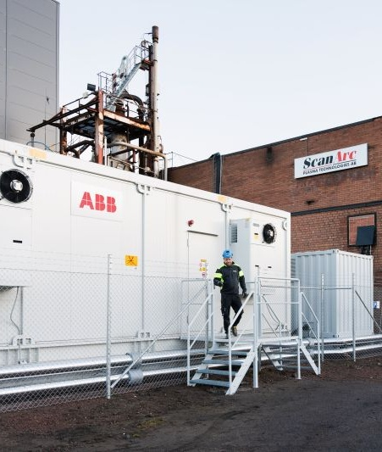
ABB's electric high-power supply to plasma torches enabling carbon-neutral industrial heat at very high temperatures
→
PROJECT REFERENCE: ELECTRIC HEATING
Who?
ScanArc develops metallurgical processes based on plasma technology to extract valuable metals from industrial residual products
What?
ACS5000 based system for application specific solution
Engineering customization with software and application control
Input transformer
Output filter, choke and disconnector
E-house
Torch ignitor
Why?
Decarbonizing hard to abate industries look for electrification of high temperature heat
ABB developing a novel high-power plasma torch application based on a well-proven product platform
Assuring quality from thorough HIL testing during development and later real-life piloting verification in deep collaboration with OEM and End-User

Slide 30
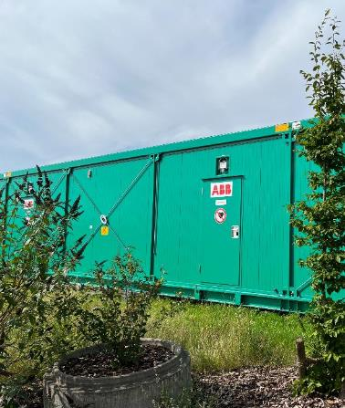
World’s largest mobile grid simulator will help drive transition to renewable energy
→
PROJECT REFERENCE: GRID SIMULATOR
Who?
Fraunhofer IWES is a leading Germany-based research and testing institute specializing in wind energy and energy system technology. Fraunhofer IWES partners with ABB to develop a mobile grid simulator to test renewable energy equipment for grid performance, stability and regulatory compliance
What?
ACS6080 power electronics grid simulator (PEGS) technology
The complete system including transformers, filters, e-houses, cooling equipment, power, and auxiliary distribution equipment
Why?
Enabling customer to bring their equipment where they need it
Putting a total of 350 ton of equipment on modularized skids to enable location independent usage of the equipment
ABB supply going far beyond supply of the solution as the concept and plant layout was engineered to the customer needs
Notes:
https://new.abb.com/news/detail/90181/worlds-largest-mobile-grid-simulator-will-help-drive-transition-to-renewable-energy

Slide 32


—
Useful links
Motion High Power overview presentation
Inside+ VSDS sales toolbox
Success stories
TECollaboration
VSDS brochure
VSDS external page – coming soon
© 2026 ABB. All rights reserved.
Slide 32

Slide 33


—
Your opinion matters
Scan the QR code
© 2026 ABB. All rights reserved.
Slide 33

